Slide 1
























Digital Image Processing (CS/ECE 545) Lecture 3: Point Operations (Part 2)
& Filters (Part 1) (Neighborhood and Spatial Processing)
Prof Emmanuel Agu
Computer Science Dept. Worcester Polytechnic Institute (WPI)

Slide 2
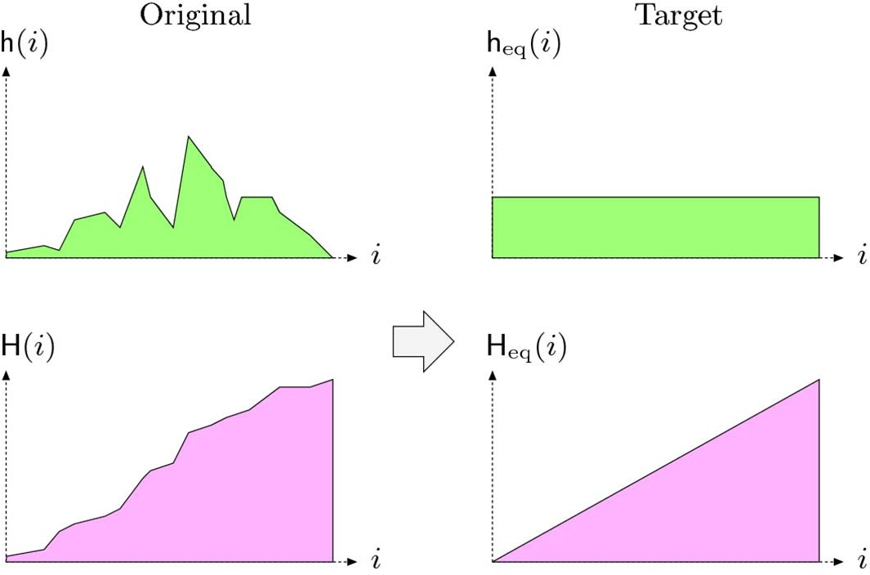
Recall: Histogram Equalization
Adjust 2 different images to make their histograms (intensity distributions) similar
Apply a point operation that changes histogram of modified image into uniform distribution
Histogram
Cumulative Histogram

Slide 3

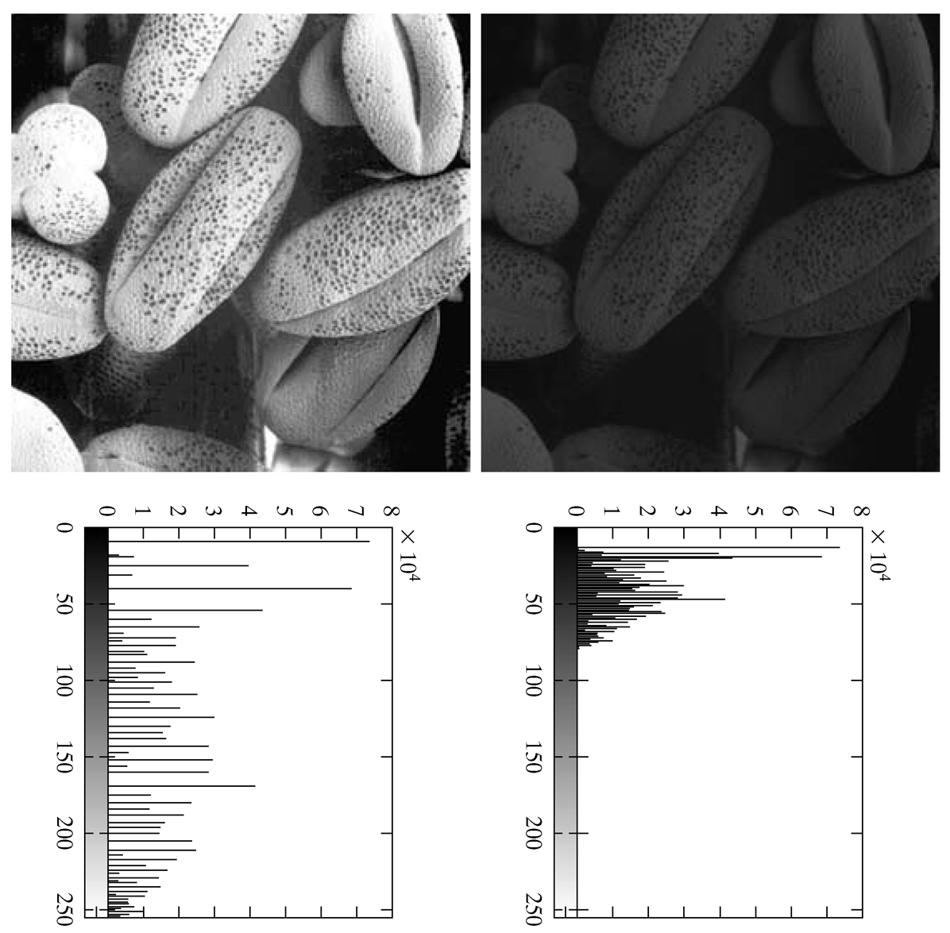
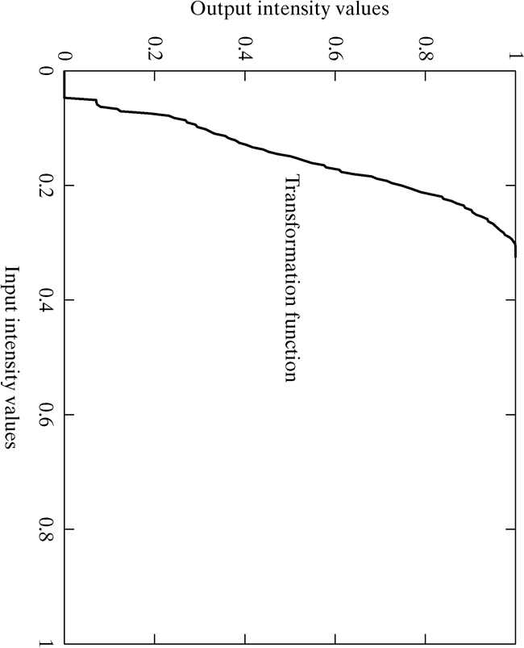
Images taken from Gonzalez & Woods, Digital Image Processing (2002)
Recall: Equalization Transformation
Function

Slide 4
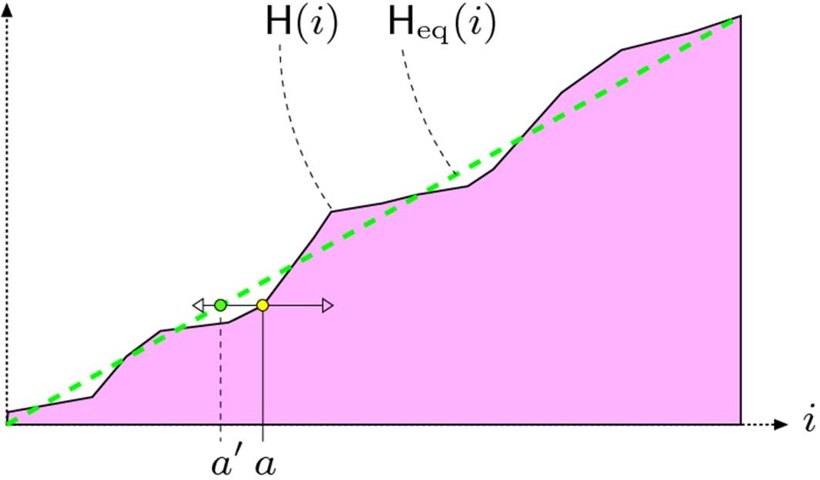
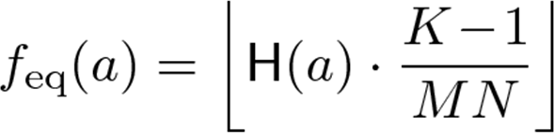
Linear Histogram Equalization
Histogram cannot be made exactly flat – peaks cannot be increased or decreased by point operations.
Following point operation makes histogram as flat as possible: (assuming M x N image and pixels in range [0, K ‐ 1])
Point operation that returns Linear equalized value of a
Cumulative Histogram: Σ how many times intensity a occurs

Slide 5
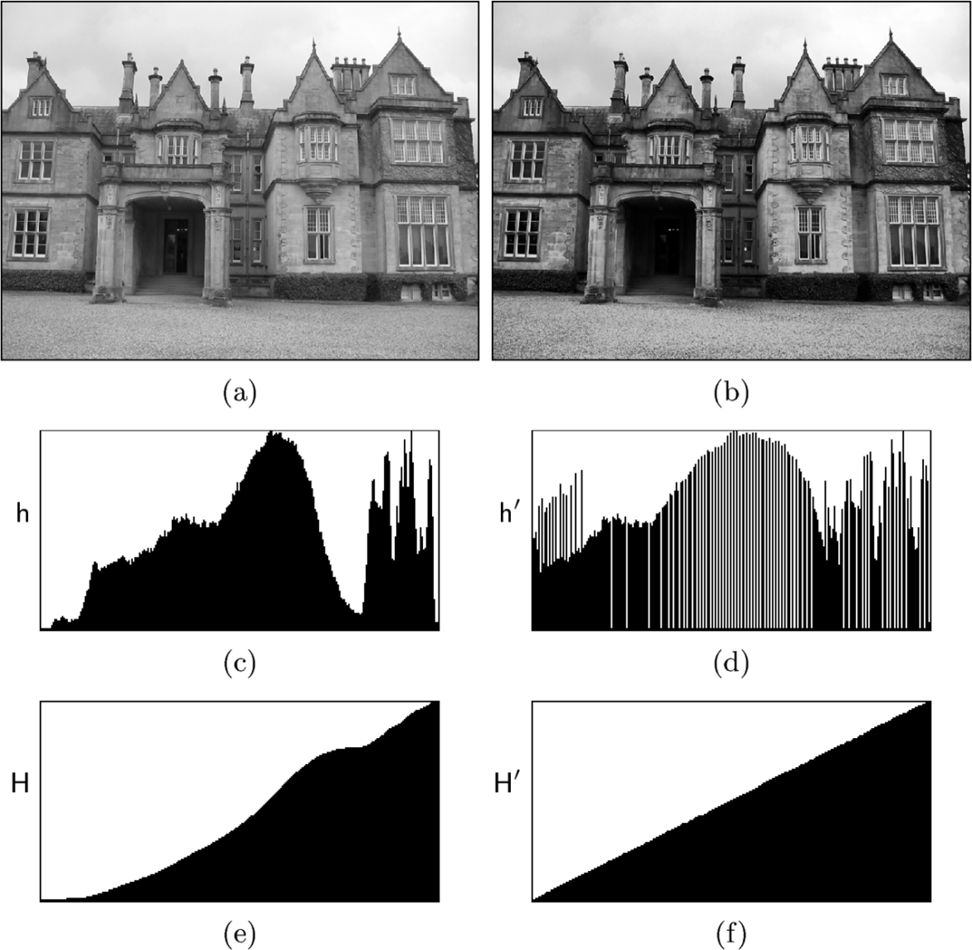
Effects of Linear Histogram Equalization
Original Image I
Image I’ after Linear Equalization
Original histogram
Histogram after Linear Equalization
Cumulative Histogram
Cumulative Histogram After Linear Equalization

Slide 6
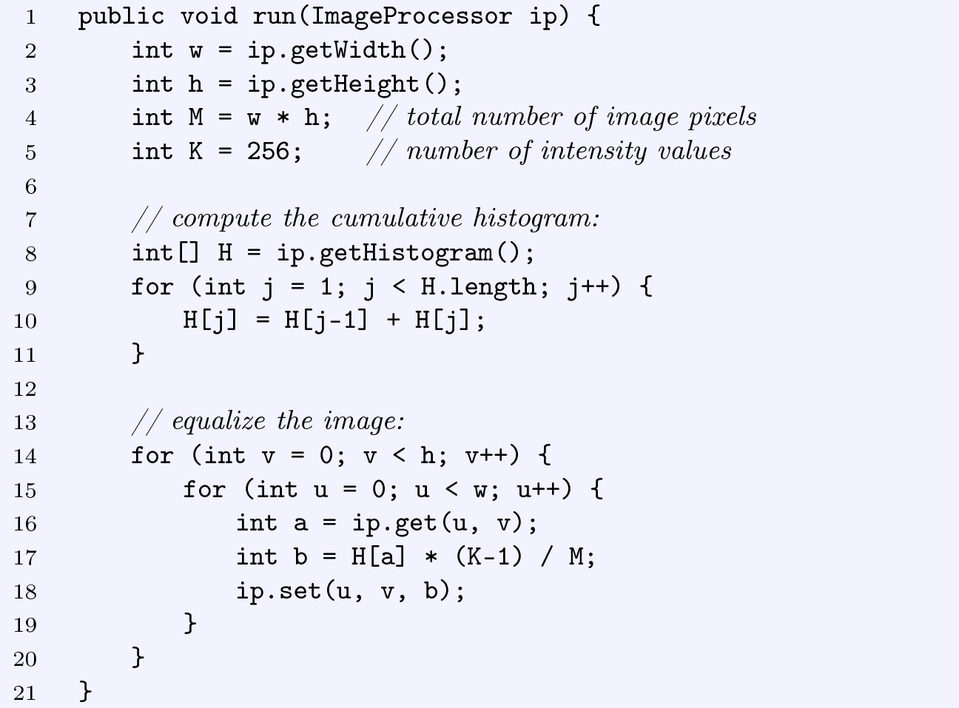

Sample Linear Equalization Code
Obtain histogram of image ip
Compute cumulative histogram in place
Get intensity value at (u,v) Equalize pixel intensity
Cumulative Histogram: Σ how many times intensity a occurs

Slide 7
Histogram Specification
Real images never show uniform distribution (unnatural)
Most real images, distribution of pixel intensities is gaussian
Histogram specification
modifies an image’s histogram into an arbitrary intensity distribution (may not be uniform)
Image 1’s histogram can also be used as target for image 2
Why? Makes images taken by 2 different cameras to appear as if taken by same camera

Slide 8
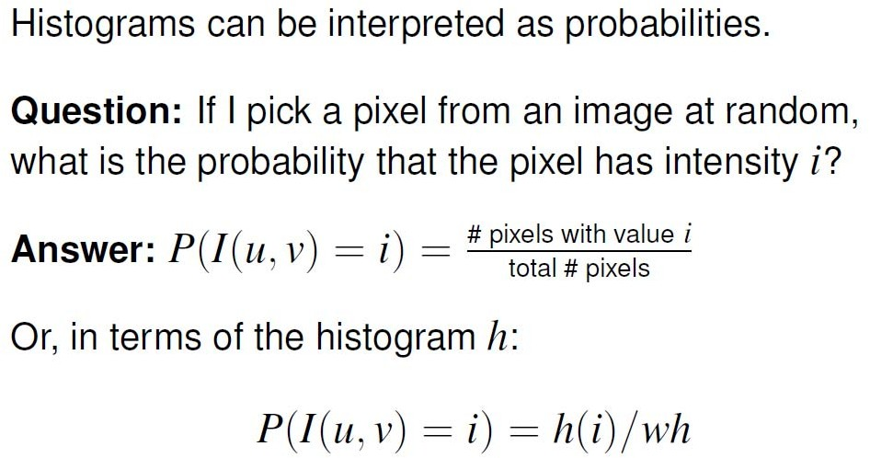
Images and Probability

Slide 9
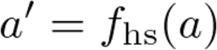
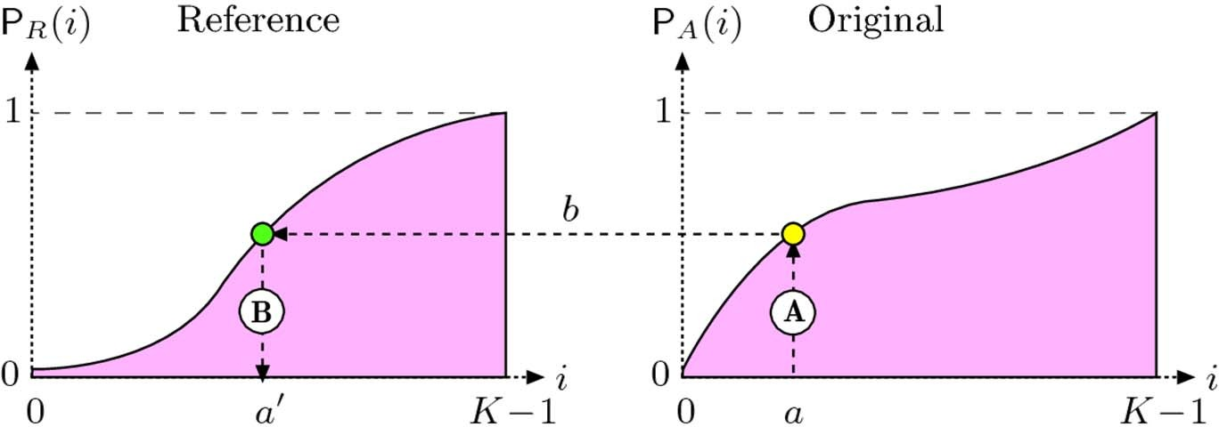
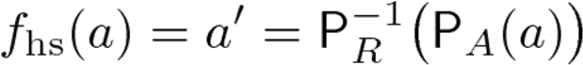
Histogram Specification
Find a mapping such that distribution of a matches some reference distribution.i.e
Mapping function: maps distribution on
right to equivalent point (same height)
On distribution on left
to convert original image I_{A} into I_{A’} such that
i.e. a and a’ have same height (b) on different CDF distributions
P⁻¹ _{R}(b)
P_{A}(a)

Slide 10
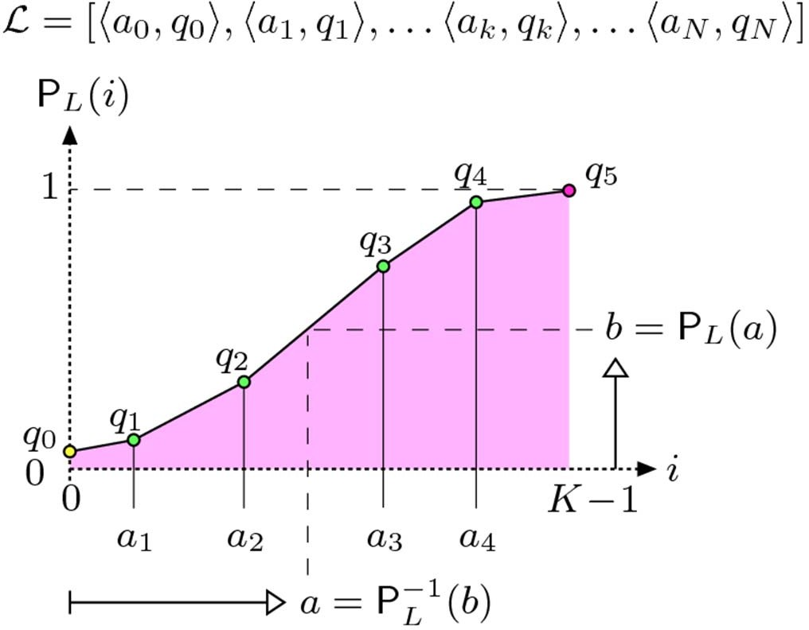
Adjusting Linear Distribution Piecewise
In practice, reference distribution may be specified as a
piecewise linear function
2 endpoints are fixed

Slide 11
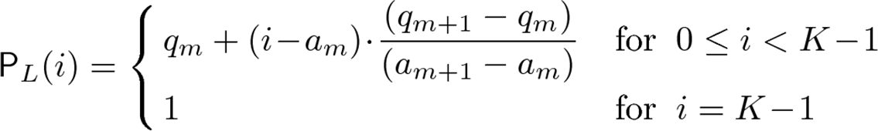
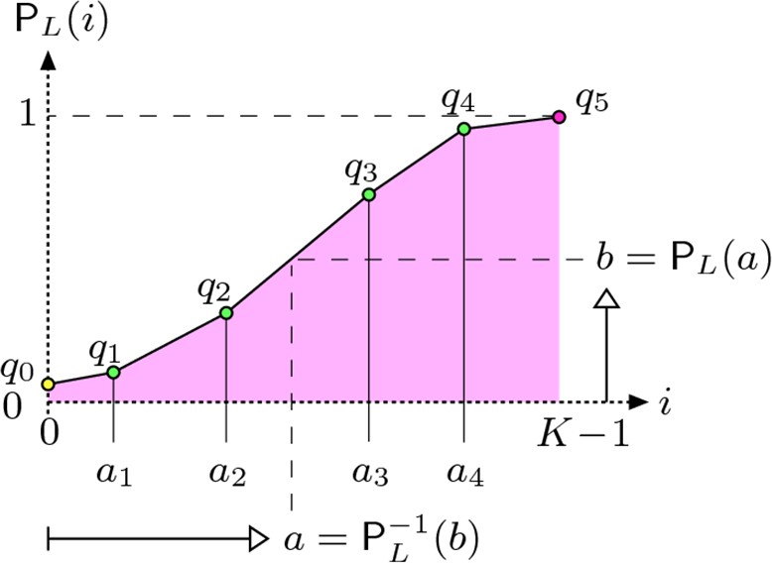
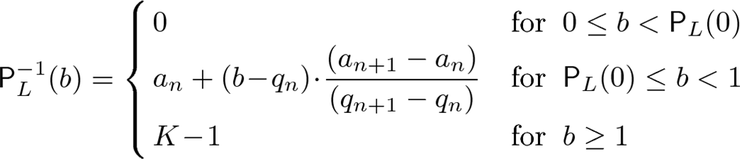
Adjusting Linear Distribution Piecewise
For each segment, linearly Interpolate to find any value
We also need the inverse mapping

Slide 12
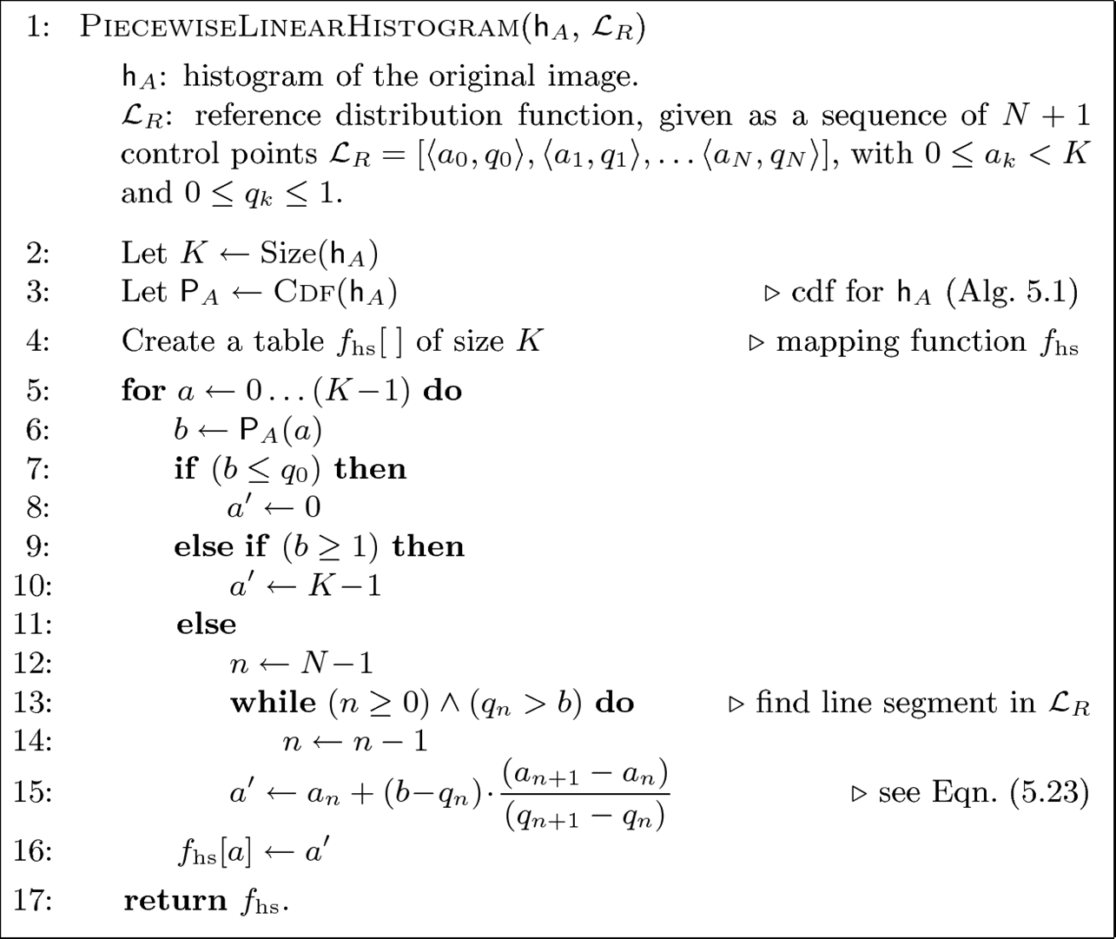
Adjusting Linear Distribution Piecewise

Slide 13
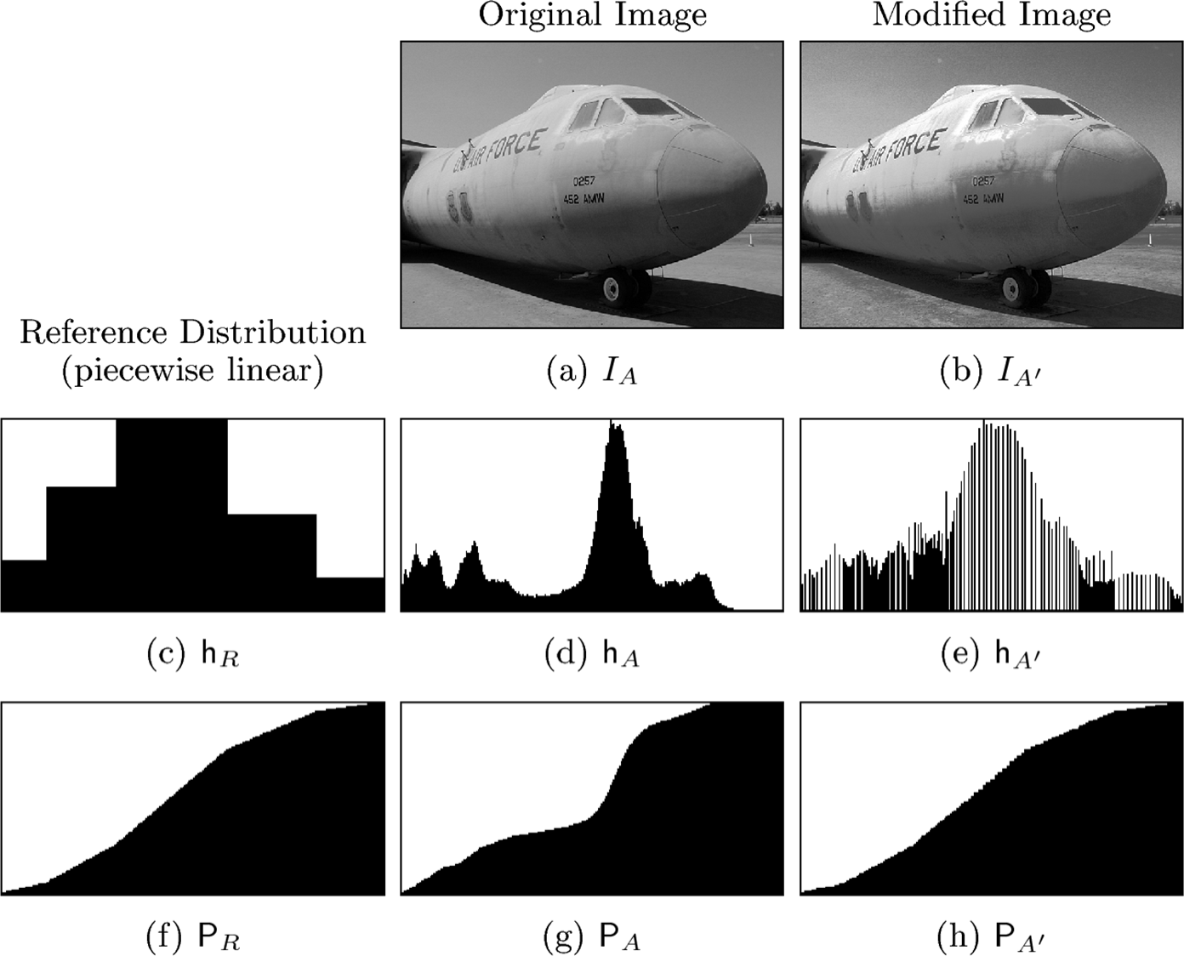
Adjusting Linear Histogram Piecewise

Slide 14
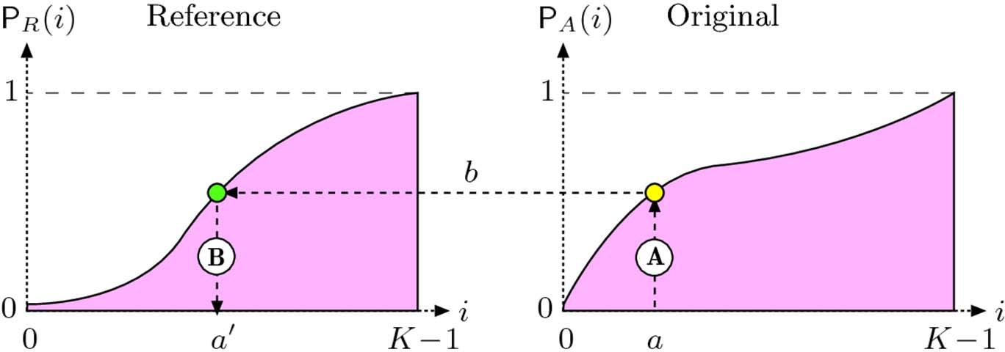

Histogram Matching
Prior method needed reference distribution to be invertible
Has to be invertible
What if reference histogram is not invertible?
For example not invertible if histogram has some intensities that occur with probability 0? i.e. p(k) = 0
Use different method called histogram matching

Slide 15
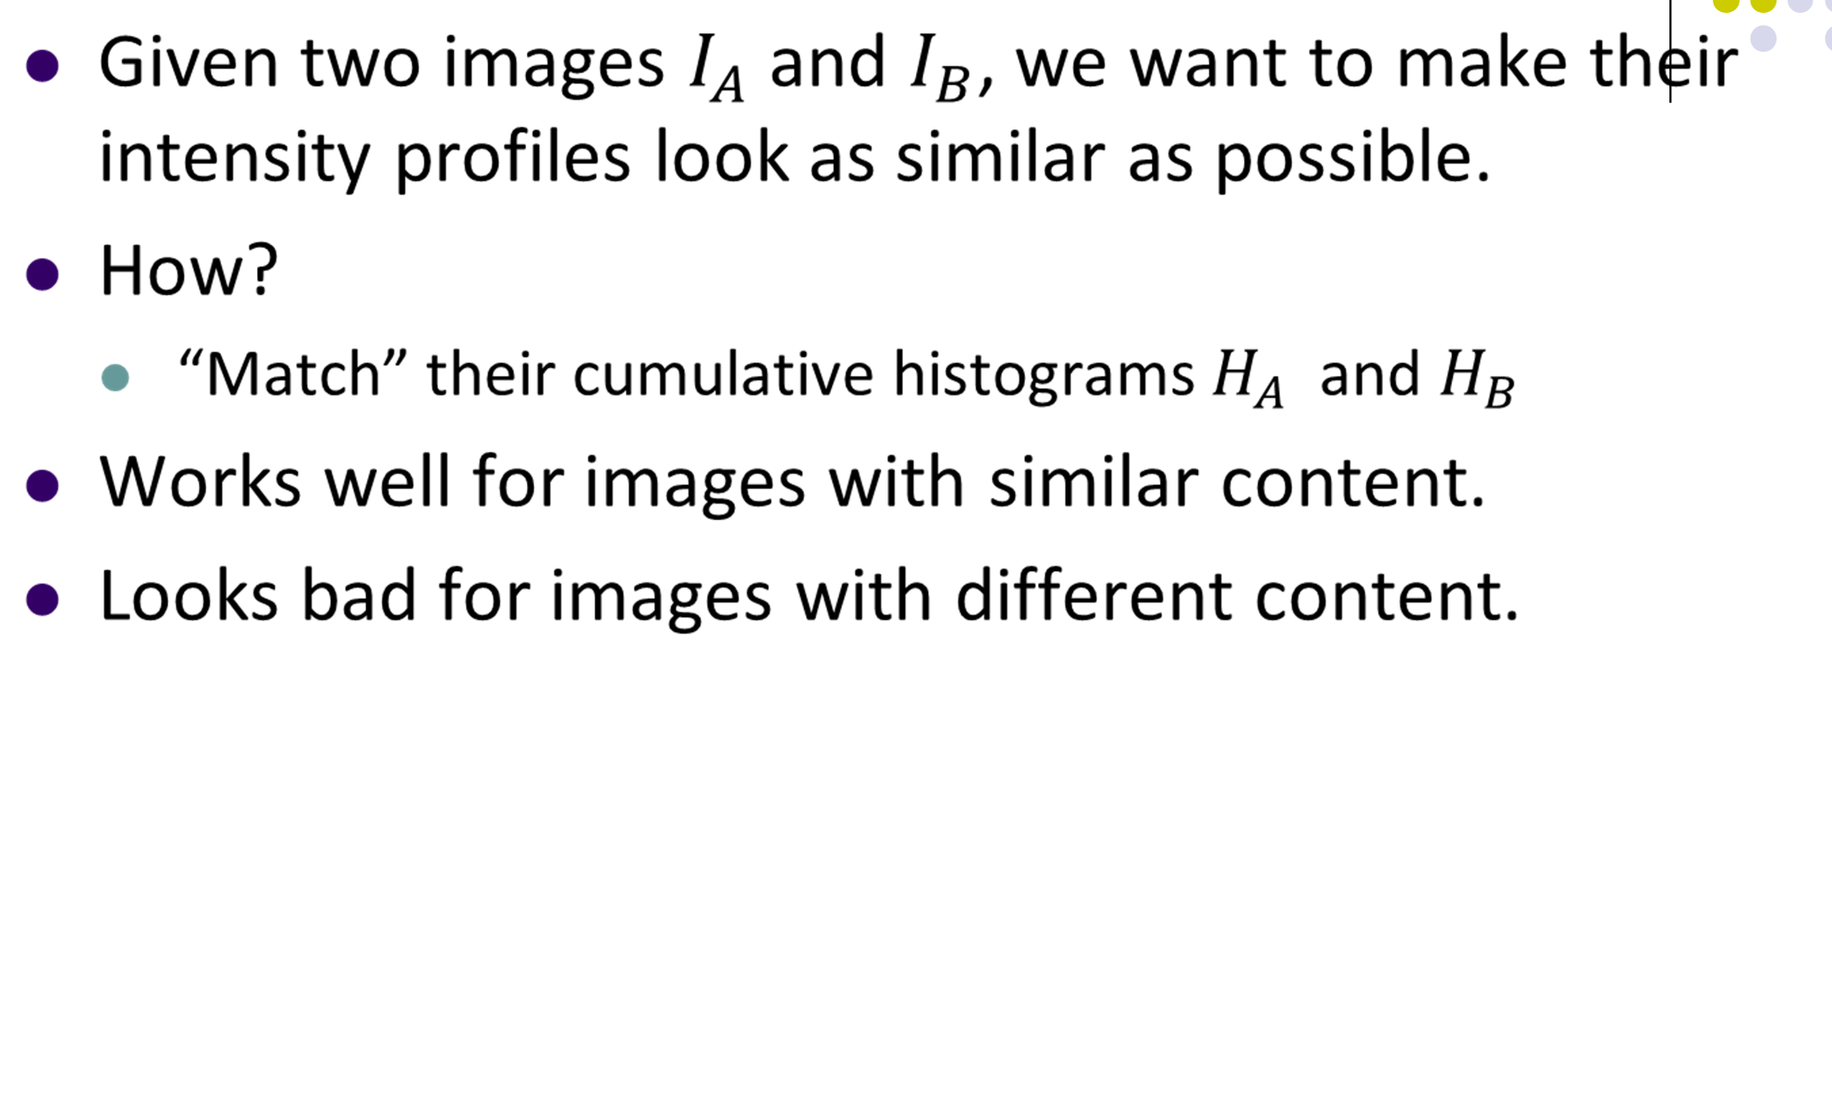
Histogram Matching
●

Slide 16
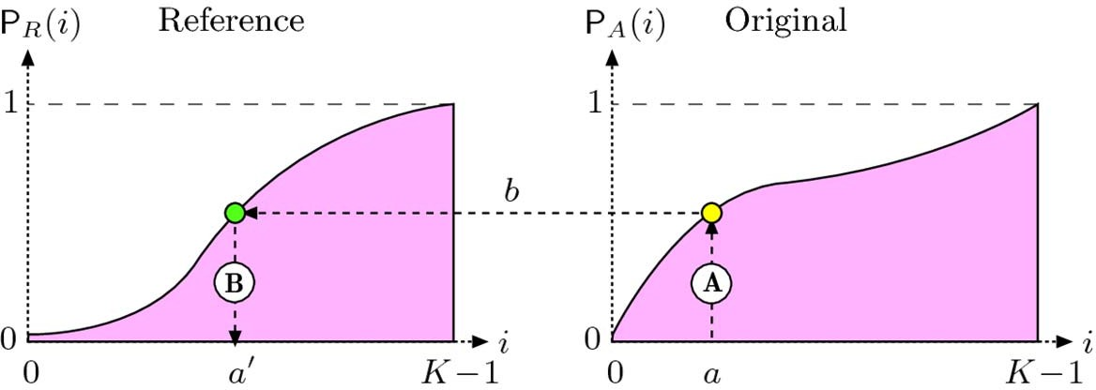
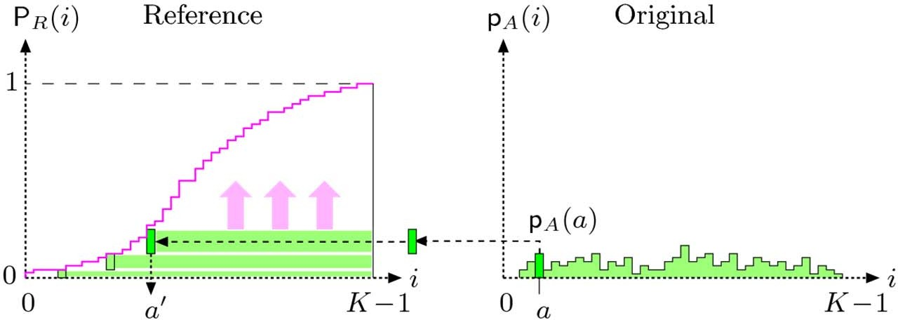
Adjusting to a Given Histogram
Reference Cumulative Distribution
Height of original Intensity on histogram
Matched intensity
Original intensity

Slide 17
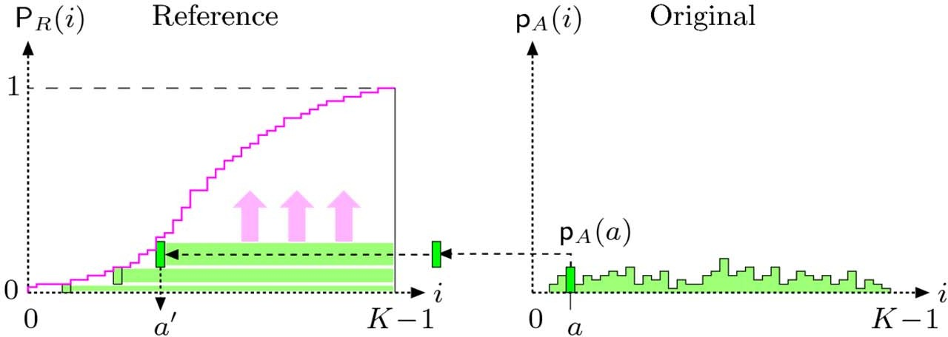
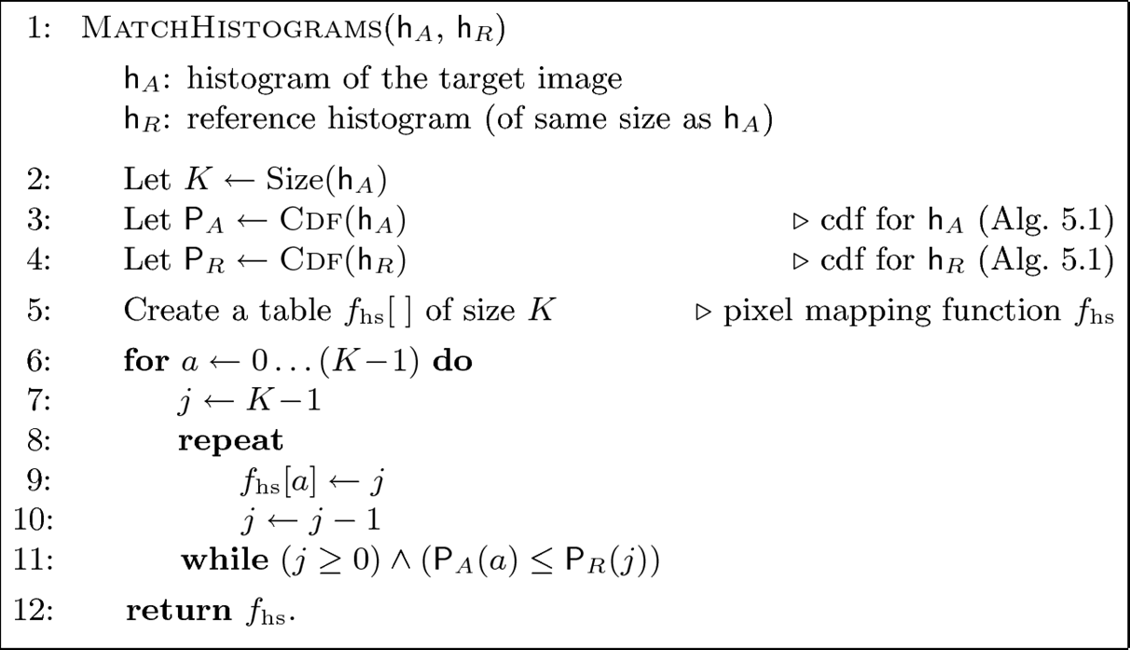
Adjusting to a Given Histogram

Slide 18
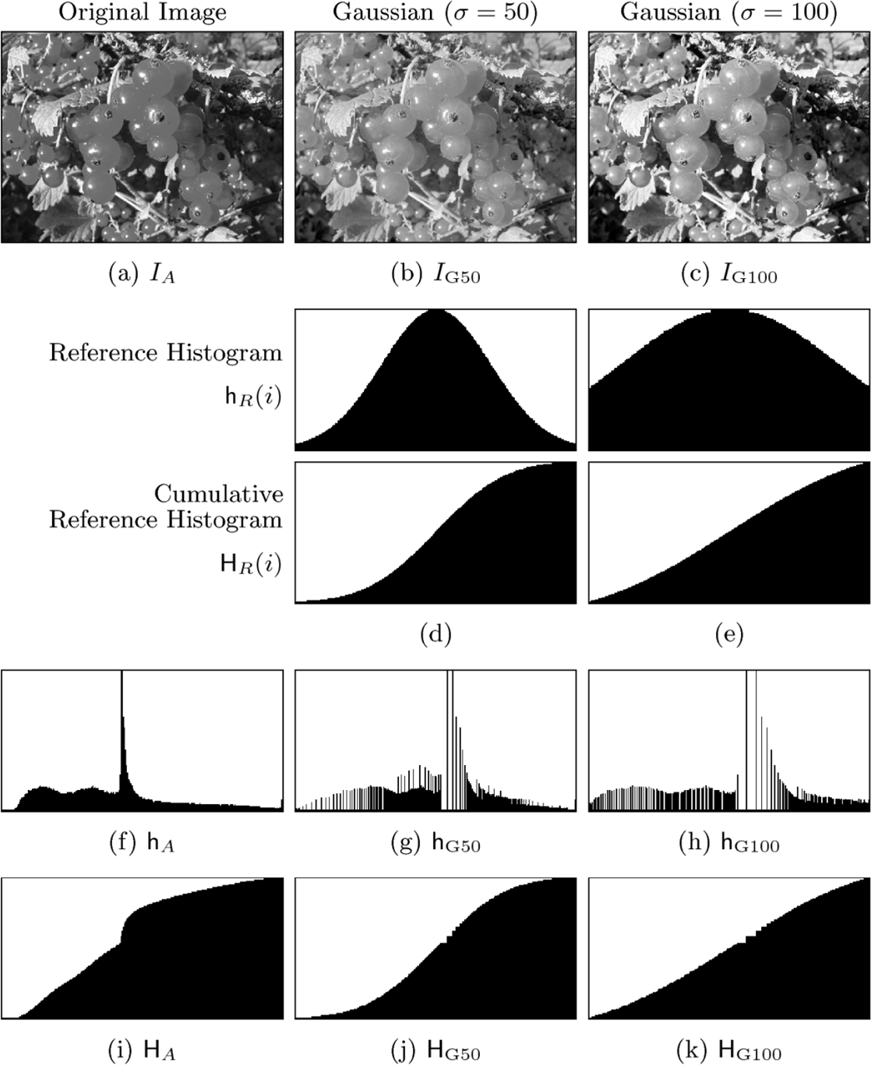
Adjusting to a Given Histogram
Original histogram after matching
original histogram
CDF of original histogram
CDF of original histogram after matching

Slide 19
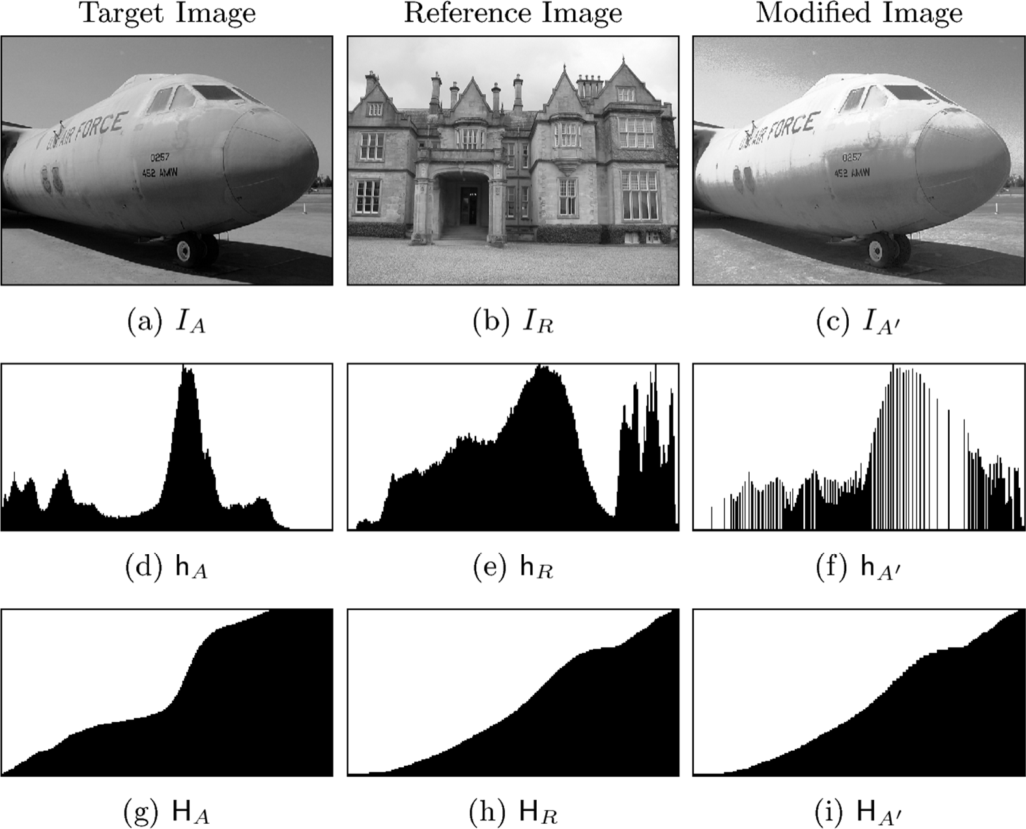
Adjusting to a Given Histogram

Slide 20
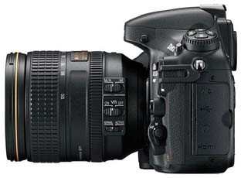
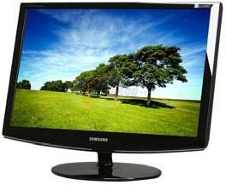
Gamma Correction
Camera
Light
Electric Signal
Light
Electric Signal
Display
Different camera sensors
Have different responses to light intensity
Produce different electrical signals for same input
How do we ensure there is consistency in:
Images recorded by different cameras for given light input
Light emitted by different display devices for same image?

Slide 21
Gamma Correction
What is the relation between:
Camera: Light on sensor vs. “intensity” of corresponding pixel
Display: Pixel intensity vs. light from that pixel
Relation between pixel value and corresponding physical quantity is usually complex, nonlinear
An approximation ?

Slide 22
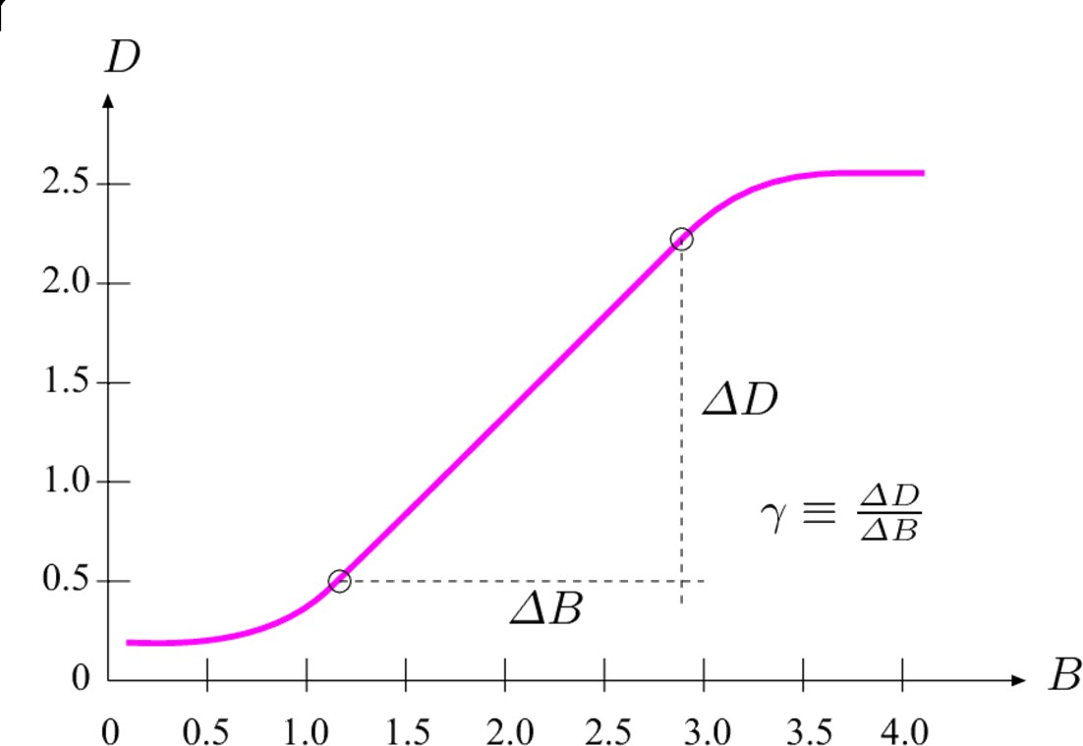
What is Gamma?
Originates from analog photography
Exposure function: relationship between:
logarithmic light intensity
Gamma: slope of linea range of the curve
The same in TV broadcasting
vs. resulting film density.
Film density (measure of response)
r
Log of light intensity

Slide 23
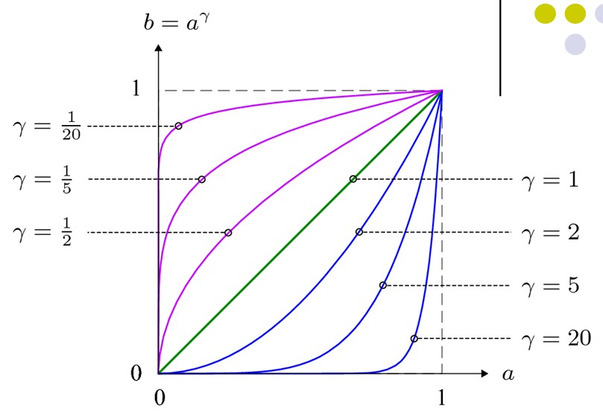
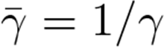
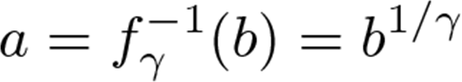
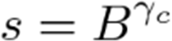
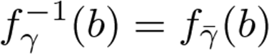
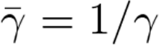
What is Gamma?
Gamma function: a good approximation of exposure curve
Inverse of a Gamma function
is another gamma function with
Gamma of CRT and LCD monitors:
1.8‐2.8 (typically 2.4)
Output signal Raised by gamma
Correct output signal
By dividing by 1/ gamma (called Gamma correction)

Slide 24
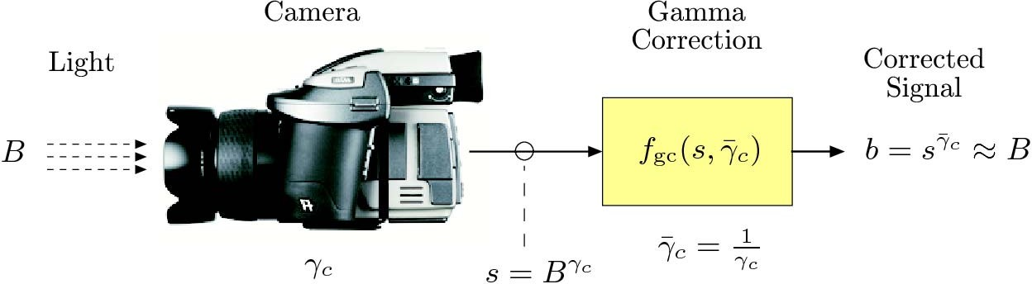
Gamma Correction
Obtain a measurement b proportional to original light intensity B by applying inverse gamma function
Gamma correction is important to achieve a device independent representation

Slide 25
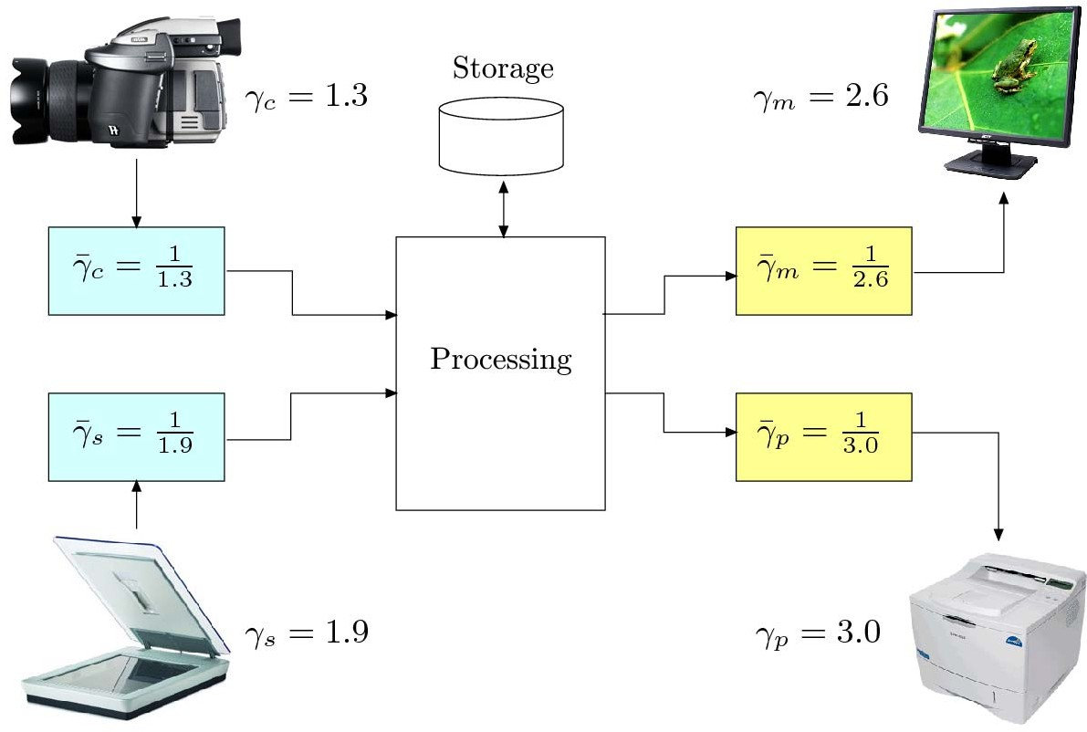
Gamma Correction

Slide 26
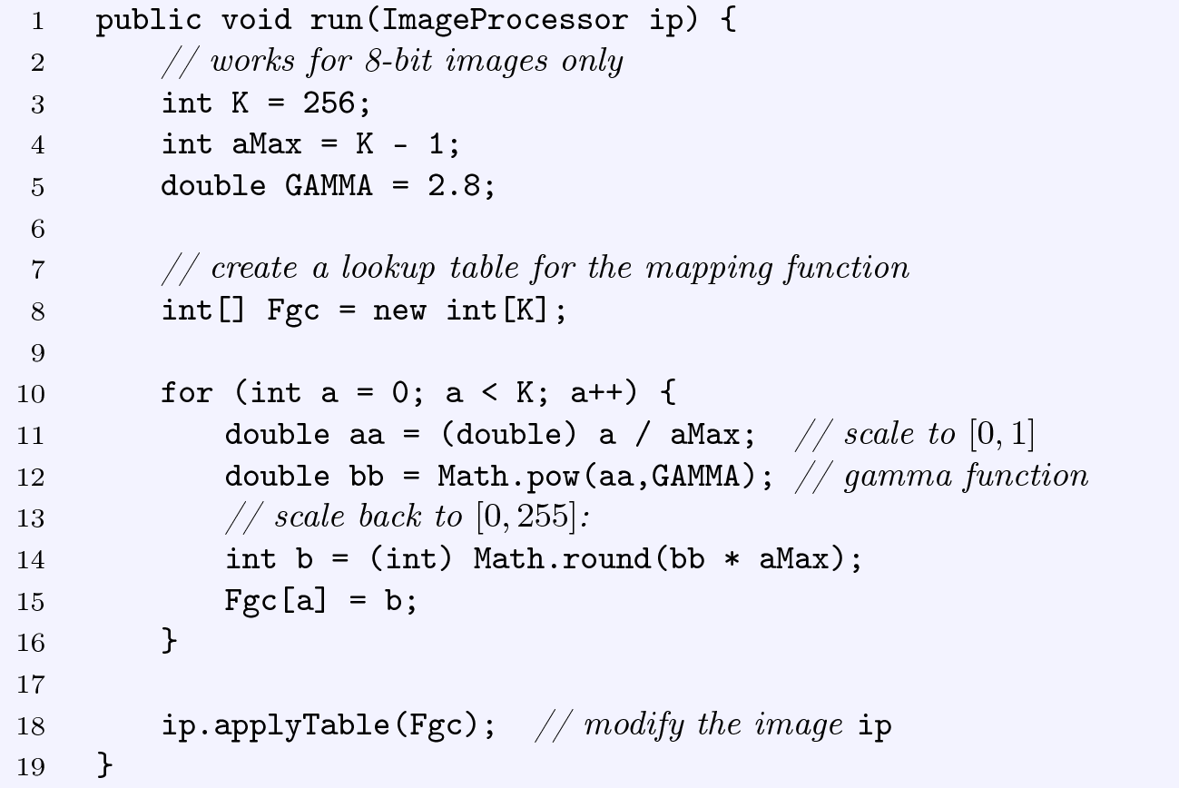
Gamma Correction Code
Compute corrected intensity and store in lookup table fgc

Slide 27
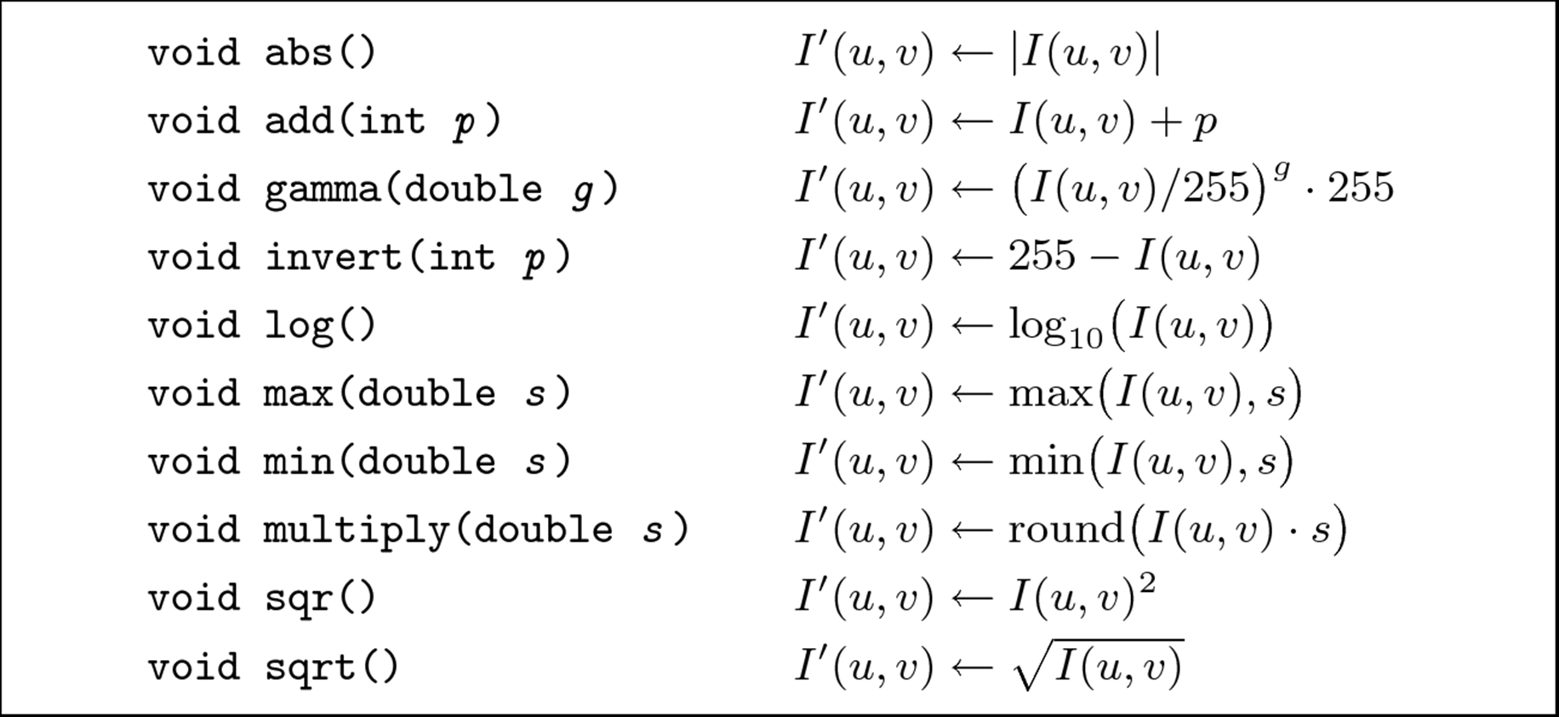
Point Operations in ImageJ

Slide 28
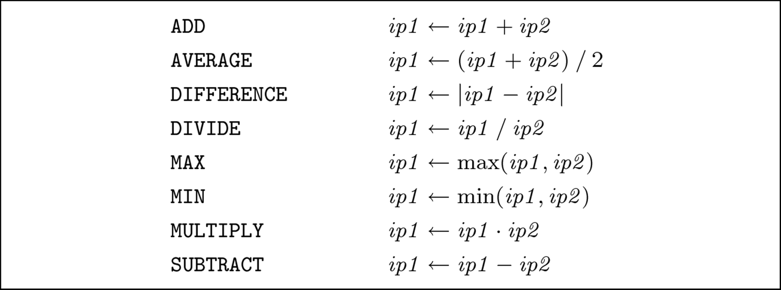
ImageJ Operations involving 2 images

Slide 29
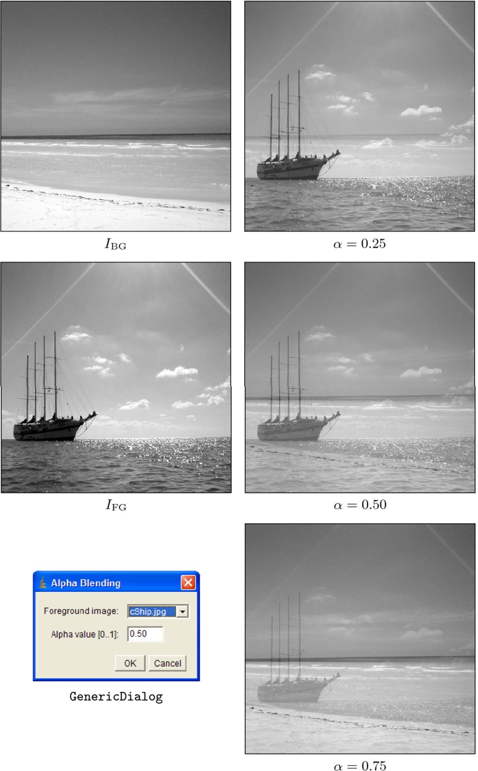
Example: Alpha Blending

Slide 30
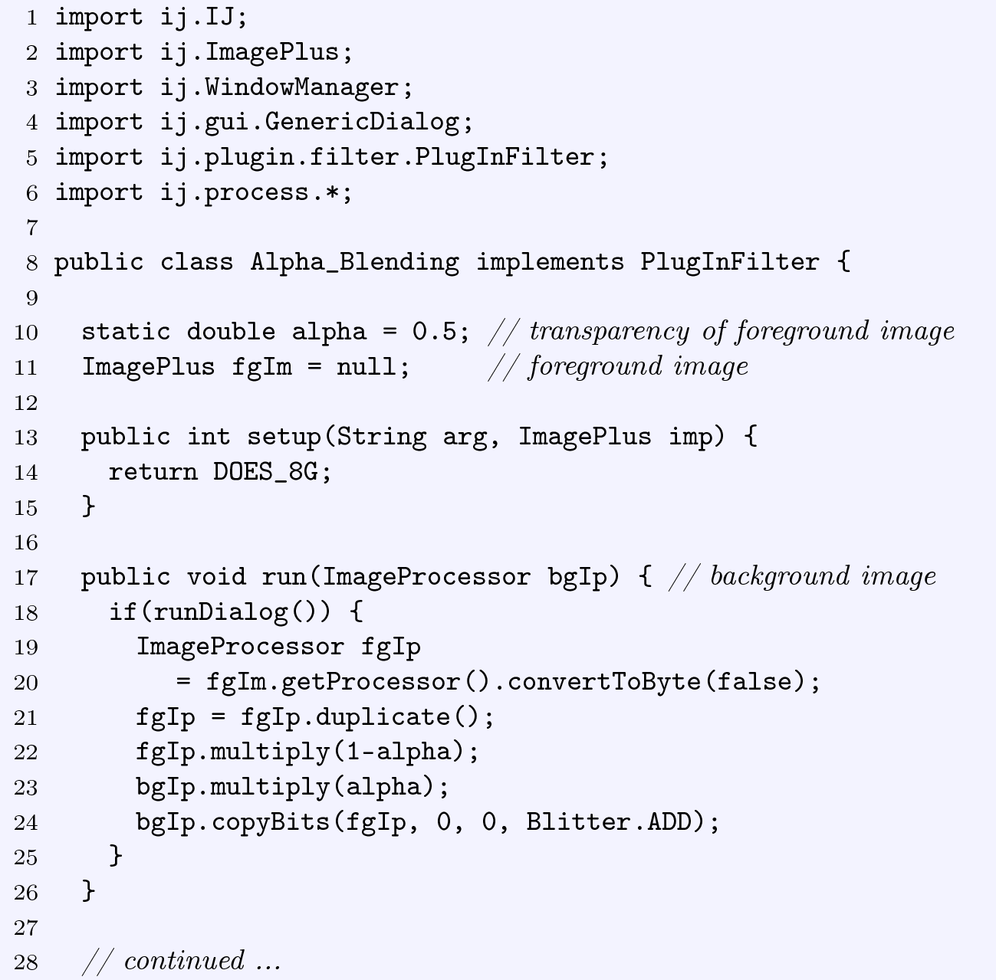
Alpha Blending PlugIn

Slide 31
What Is Image Enhancement?
Image enhancement makes images more useful by:
Highlighting interesting detail in images
Removing noise from images
Making images more visually appealing

Slide 32

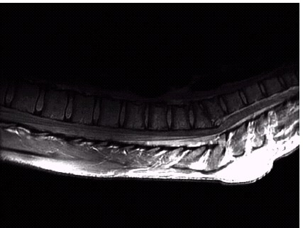
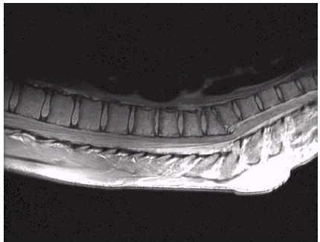
Images taken from Gonzalez & Woods, Digital Image Processing (2002)
Image Enhancement Examples

Slide 33
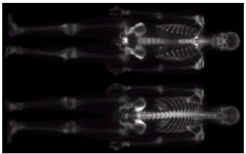
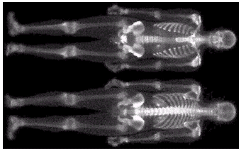
Images taken from Gonzalez & Woods, Digital Image Processing (2002)
I
E
mage
nhancement
E
(
xamples
cont…)

Slide 34
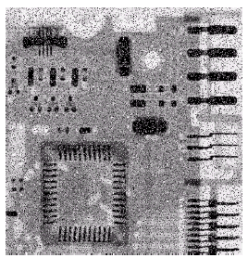
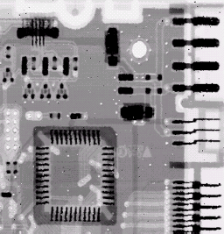
Images taken from Gonzalez & Woods, Digital Image Processing (2002)
Image Enhancement Examples (cont…)

Slide 35
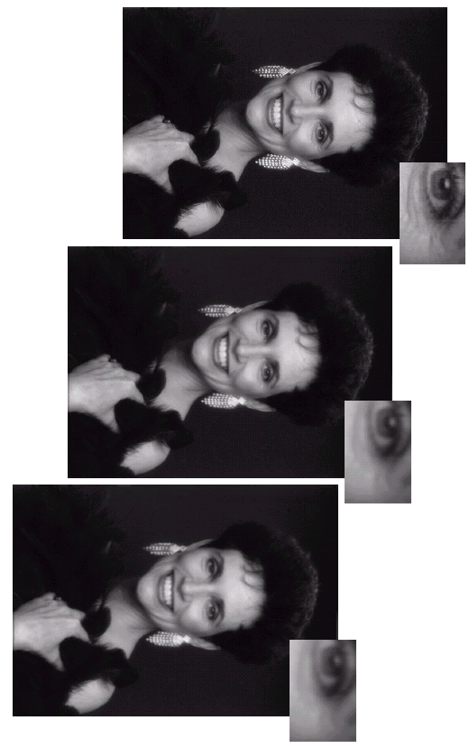
Images taken from Gonzalez & Woods, Digital Image Processing (2002)
Image Enhancement Examples (cont…)

Slide 36
Spatial & Frequency Domains
There are two broad categories of image enhancement techniques
Spatial domain techniques
Direct manipulation of image pixels (intensity values)
Frequency domain techniques
Manipulation of Fourier transform or wavelet transform of an image
First spatial domain techniques Later: frequency domain techniques

Slide 37
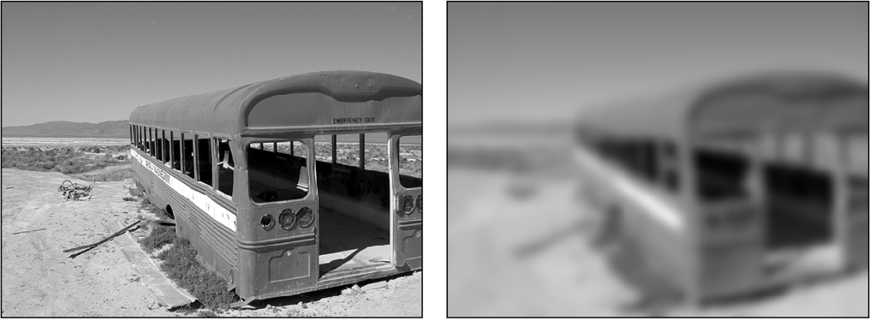
What is a Filter?
Capabilities of point operations are limited
Filters: combine pixel’s value + values of neighbors
E.g blurring: Compute average intensity of block of pixels
Combining multiple pixels needed for certain operations:
Blurring, Smoothing
Sharpening

Slide 38
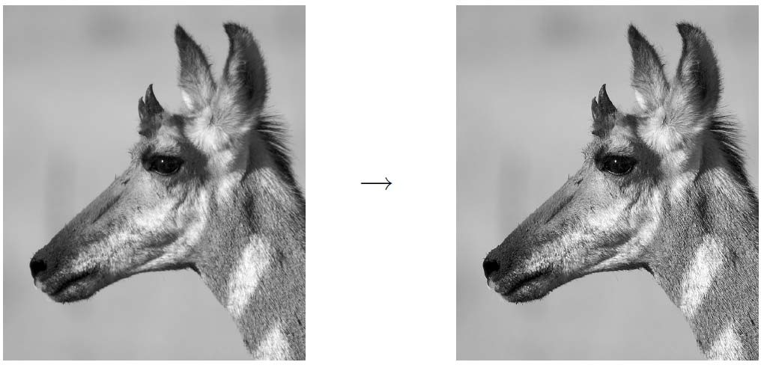
What Point Operations Can’t Do
Example: sharpening

Slide 39

What Point Operations Can’t Do
Other cool artistic patterns by combining pixels

Slide 40


Definition: Spatial Filter
●

Slide 41

Example: Average (Mean) of 3x3 Neighborhood
pixel
8 neighbor pixel
Blurring: Replace each pixel with AVERAGE Intensity of pixel + neighbors

Slide 42


Smoothing an Image by Averaging
Replace each pixel by average of pixel + neighbors
For 3x3 neighborhood:

Slide 43



Smoothing an Image by Averaging

Slide 44











Example: Smoothing Spatial Filtering
Origin x
104 100 108
99 106 98
95 90 85
Original Image Pixels
1_{/9} | 1_{/9} | 1_{/9}
1_{/9} | 1_{/9} | 1_{/9}
1_{/9} | 1_{/9} | 1_{/9}
 | Filter
*
1/ 1/ 1/
Simple 3*3 Neighbourhood
104
100
108
3*3 Smoothing Filter
9
9 9
1/ | 1/ | 1/
1/ | 1/ | 1_{/9}
99
106
98
9
9 9
95
90
85
e = ¹/₉*106 +
¹/₉*104 + ¹/₉*100 + ¹/₉*108 +
¹/₉*99 + ¹/₉*98 +
¹/₉*95 + ¹/₉*90 + ¹/₉*85
= 98.3333
9
9
y
Image f (x, y)
The above is repeated for every pixel in the original image to generate the smoothed image

Slide 45


Smoothing an Image by Averaging
Previous example: Filter size: 3x3
Many possible filter parameters (size, weights, function, etc)
Filter size (size of neighborhood): 3x3, 5x5, 7x7, …,21x21,..
Filter shape: not necessarily square. Can be rectangle, circle, etc
Filter weights: May apply unequal weighting to different pixels
Filters function: can be linear (a weighted summation) or nonlinear

Slide 46



The Filter Matrix
Filter operation can be expressed as a matrix Example: averaging filter
Filter matrix also called filter mask H(i,j)

Slide 47

Example: What does this Filter Do?

Slide 48

What Does this Filter Do?

Slide 49

Mean Filters: Effect of Filter Size

Slide 50


Applying Linear Filters: Convolution
For each image position I(u,v):
1. Move filter matrix H over image such that H(0,0) coincides with current image position (u,v)
Multiply all filter coefficients H(i,j)
with corresponding pixel
I(u + i, v + j)
Sum up results and store
sum in corresponding position in new image I’(u, v)
Stated formally:
R_{H} is set of all pixels Covered by filter.
For 3x3 filter, this is:

Slide 51

Computing Filter Operation
Filter matrix H moves over each pixel in original image I to compute corresponding pixel in new image I’
Cannot overwrite new pixel value in original image I Why?
Store results I’ in intermediate image, then copy back to replace I
Copy original image I to intermediate image, use it as source, then store results I’ to replace original image

Slide 52


Simple 3x3 Averaging Filter (“Box” Filter)
No explicit filter matrix since all coefficients are the same (1/9)
No clamping required
Make copy of original image to use as source
Loop over all pixels in image
Filter computation by adding current pixel’s neighbors
Store result back in original image

Slide 53
Weighted Smoothing Filters
More effective smoothing filters can be generated by allowing different pixels in the neighbourhood different weights in the averaging function
Pixels closer to central pixel more important
Often referred to as a
weighted averaging
Weighted averaging filter
^{1/}16 | ^{2/}16 | ^{1/}16
^{2/}16 | ^{4/}16 | ^{2/}16
^{1/}16 | ^{2/}16 | ^{1/}16

Slide 54



Another Smoothing Filter
Use real filter matrix with coefficents Apply bell-shaped function H(i,j)
Bell-shaped function H(i,j)?
- More weight applied to center
Apply filter
Store result back in original

Slide 55


Integer Coefficients
Instead of floating point coeffients, more efficient, simpler to use:
scaling factor + integer coefficients

Slide 56


Example: 5x5 Filter in Adobe Photoshop
Integer filter coefficients
If resulting pixel value is negative, offset shifts it into visible range
Scaling factor for coeffients

Slide 57

Computation Range
For a filter of size (2K+1) x (2L+1), if image size is MxN, filter is computed over the range:
Filter can only be applied at image locations (u, v) where filter matrix H is fully contained in the image

Slide 58

Filter of Arbitrary Size
Declare filter
Clamp result as a precaution

Slide 59

What to do at image boundaries?
a) Crop

Slide 60

What to do at image boundaries?
Crop
Pad

Slide 61

What to do at image boundaries?
Crop
Pad
Extend

Slide 62

What to do at image boundaries?
Crop
Pad
Extend
Wrap

Slide 63

Linear Filters: Smoothing Filters
2 main classes of linear filters:
Smoothing: +ve coeffients (weighted average). E.g box, gaussian
Difference filters: +ve and –ve weights. E.g. Laplacian
Box
Gaussian
Laplacian

Slide 64

Gaussian Filter
where
σ is width (standard deviation)
r is distance from center
σ
r
Gaussian filter

Slide 65



Difference Filters
Coefficients: some +ve, some negative
Example: Laplacian filter
Computation is difference
Laplacian filter

Slide 66




Mathematical Properties of Convolution
Applying a filter as described called linear convolution
For discrete 2D signal, convolution defined as:

Slide 67


Properties of Convolution
Commutativity
Same result if we convolve
image with filter or vice versa
Linearity
If image multiplied by scalar Result multiplied by same scalar
(notice)
If 2 images added and convolve result with a kernel H,
Same result if each image
is convolved individually + added
Associativity
Order of filter application irrelevant Any order, same result

Slide 68
References
Wilhelm Burger and Mark J. Burge, Digital Image Processing, Springer, 2008
Histograms (Ch 4)
Point operations (Ch 5)
Filters (Ch 6)
University of Utah, CS 4640: Image Processing Basics, Spring 2012
Rutgers University, CS 334, Introduction to Imaging and Multimedia, Fall 2012

